Slide 1
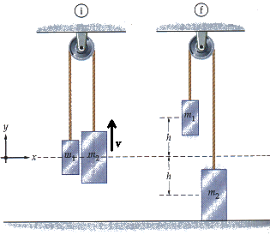
Using Newton’s Laws and Pulley Problems

Slide 2
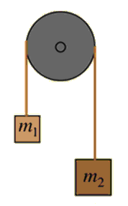
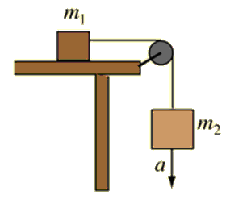
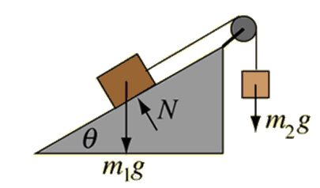
The Advantage of Pulleys
Pulleys are tools that allow us to change the direction of force, without changing it’s magnitude
We assume:
Strings are unstretchable and massless
Pulleys are frictionless
Notes:
Also called “Atwood’s Machine” Invented by George Atwood, in 1784, Atwood’s machine consists of two unequal masses connected by a string passed over a pulley.

Slide 3

Strategy
1. Draw a FBD for EACH MASS.
2. Write two net force statements
- Using Newton’s Second Law
- Using the FBD
(write this statement such that acceleration will be positive)
3. Solve the system

Slide 4
The Advantage of Pulleys
Draw a FBD for each of the following pulley systems. Then write both net force statements.
Notes:
Assume the systems are frictionless.

Slide 5
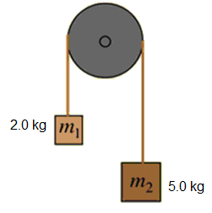
Example
For the system below, calculate:
The magnitude of the acceleration of the system
The magnitude of the tension in the rope
Notes:
Before we can begin we must decide which way the system will accelerate.

Slide 6
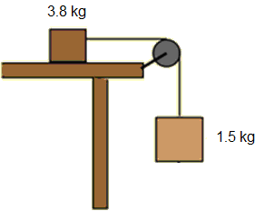
Example
Consider a frictionless table with one mass resting on top and a second hanging over a pulley as shown below. Determine:
The magnitude of the acceleration of the system
The magnitude of the tension in the rope
3.0 kg

Slide 7
Adding Friction
Now assume the block resting on the table experienced a friction force of 1.2 N [back]. Calculate:
The new magnitude of the acceleration of the system.
The new magnitude of the tension in the rope.
3.0 kg

Slide 8
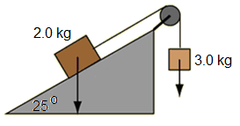
Example:
Consider a frictionless ramp with the masses set up as shown below. Calculate:
The magnitude of the acceleration of the system.
The magnitude of the tension in the rope.

Slide 9
